Slide 1


Multi-core: Global Scheduling
Md Mostafizur Rahman
Electronic Engineering,
Hochschule Hamm-Lippstadt (HSHL)
Seminar: Real-Time Systems · Prof. Stefan Henkler

Slide 2

Agenda
01
Motivation & Problem Statement
06
Local Experiment: Methodology & Results
02
07
Cross-Platform Comparison & Application Example
G-EDF vs. P-EDF: Background & Comparison
03
OS Overhead and WCET Inflation
08
UPPAAL Formal Verification — Windows & Linux
04
EPOS vs. LITMUSᴿT
09
Schedulability Analysis: Utilization vs. Deadline
05
WCET Inflation Formula
10
Evaluation & Limitations
2

Slide 3

Motivation & Problem Statement
Why this matters
Multicore chips are common in embedded and automotive systems.
ADAS, braking control, sensor fusion, and vision tasks require deterministic timing.
More cores increase computing power, but do not automatically guarantee deadlines.
OS overhead and interference inflate effective WCET.
deadline

Slide 4

Global vs. Partitioned Scheduling
G-EDF
P-EDF
G
Core 1
Core 1
Queue 1
one global
ready queue
Core 2
Queue 2
Core 2
HOW IT WORKS
HOW IT WORKS
One global ready queue ordered by earliest deadline; the m earliest-deadline jobs run on the m cores.
Tasks are statically assigned to cores via bin-packing; each core runs EDF locally on its own task set.
MAIN BENEFIT
MAIN BENEFIT
Good load sharing — flexible use of all cores.
No migration after partitioning; often lower runtime interference.
MAIN RISK
MAIN RISK
Migrations, IPI latency, cache-affinity loss, pessimistic schedulability tests.
NP-hard bin-packing can fail even when total utilization fits.
Src:Image Generated With Chatgpt 5.5
4

Slide 5

G-EDF Algorithm
1
Job release
2
Enqueue globally
3
Select earliest m
Compute absolute_deadline = release_time + relative_deadline.
→
Insert the job into one global ready queue ordered by absolute deadline — O(n) insertion.
→
Select the m jobs with earliest deadlines from the queue.
4
Dispatch
5
Preempt if needed
6
Re-queue
Dispatch the selected jobs to the available cores — O(1).
→
A newly released job with an earlier deadline preempts a running lower-priority job; an IPI triggers the remote reschedule.
→
The preempted job returns to the global queue and may resume on another core (migration).
Algorithm 1: Before any schedulability test, Eq. (1) is applied to each eᵢ → e′ᵢ. The dispatch logic itself never errs — a preempted job re-enters the queue and may resume on a different core.
5

Slide 6

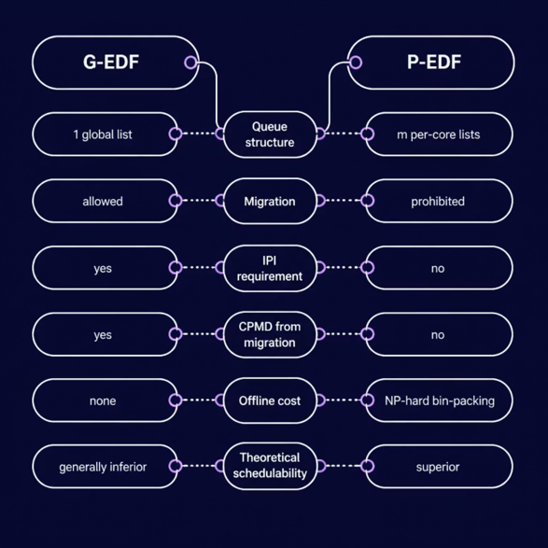
G-EDF vs. P-EDF: Algorithm Comparison
Src:Image Generated With Chatgpt 5.5
6

Slide 7
OS Overhead and WCET Inflation
Overhead Source | Explanation | Relation to G-EDF
Context switch | Time to save/restore task context | Occurs when tasks are preempted or switched
Scheduling decision | Time to select the next job | Global queue cost grows with task count
Thread release | Time to make periodic jobs ready | Occurs when jobs are released
Tick counting | Timer interrupt handling overhead | Can disturb execution periodically
IPI latency | Delay for a cross-core reschedule request | Important in global scheduling
CPMD | Cache delay after preemption / migration | Important when jobs migrate between cores
inflated WCET = original WCET + overhead / interference
inflated WCET = original WCET + overhead / interference
7

Slide 8

EPOS vs. LITMUSᴿT
Overhead Source | EPOS (WC) | LITMUSᴿT (WC) | Factor
Context switch | 0.30 µs | ≤ 29.56 µs | 76×
IPI latency | ~0.30 µs | ≤ 4.5 µs | 15×
Scheduling G-EDF | O(n), stable < 75 | Unpredictable | 7×
Scheduling P-EDF | O(n/m), stable | Unpredictable | 21×
Tick counting | 0.25 µs (const) | Grows with n | 84×
Table 3: worst-case overhead, Intel i7-2600, 100 runs across 5–125 tasks (Gracioli et al. [1])
We see that with low-overhead EPOS, G-EDF outperforms P-EDF on LITMUSRT in light-utilization, short-period task sets reversing the theoretical ordering.
OS design quality can determine the practical ordering of G-EDF and P-EDF, independently of scheduling theory.
8

Slide 9



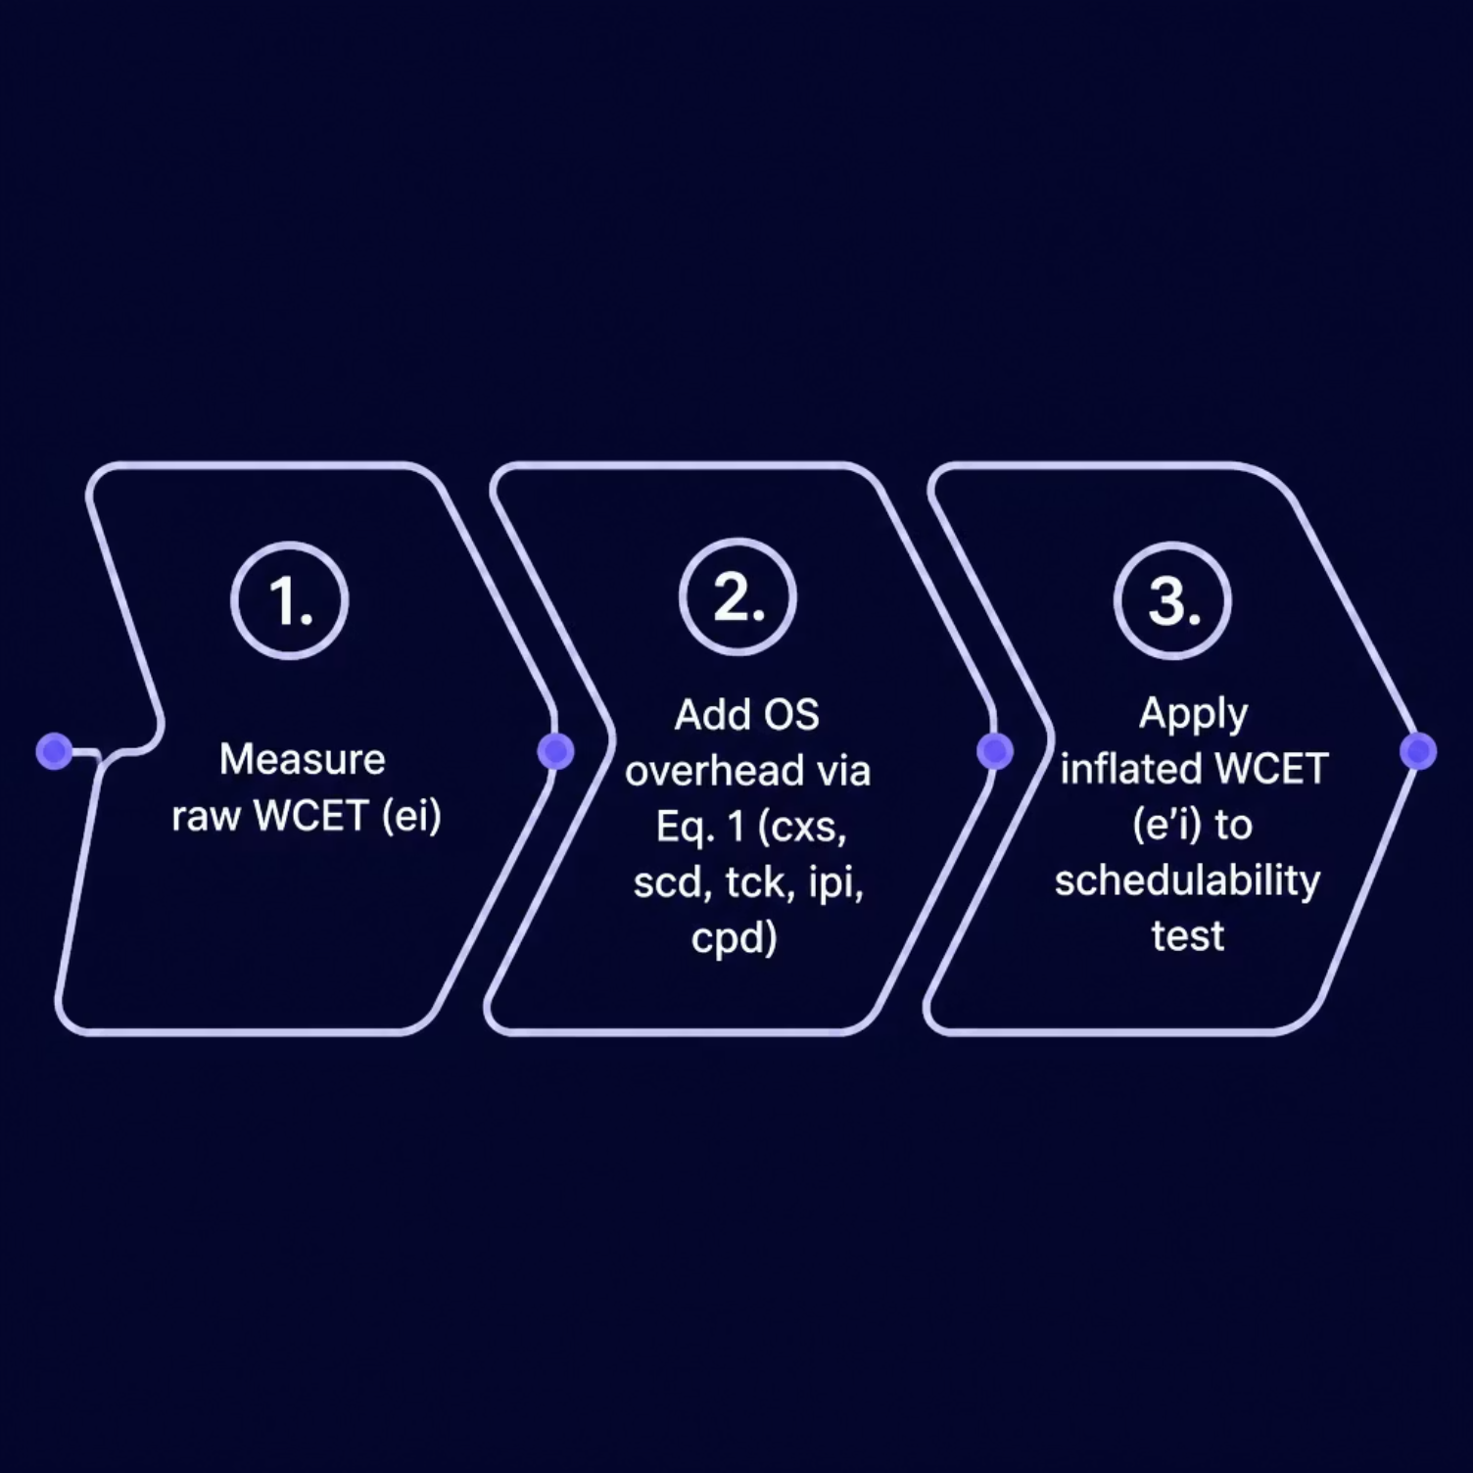
WCET Inflation Formula
PREEMPTION-CENTRIC WCET INFLATION (Brandenburg [3], Eq. 1–2)
Interpretation
2(scd+cxs): scheduler and context-switch cost around release/completion.
cpd: cache-related delay after preemption or migration.
ipi: treated as computation because G-EDF tests cannot handle self-suspension.
the OS changes effective WCET, and WCET changes schedulability.
Src:Image Generated With Chatgpt 5.5
9

Slide 10


Experiment: Measuring WCET
Task under test: CPU-bound arithmetic loop — x += i² for 5,000,000 iterations
Platform: AMD Ryzen 7 7435HS (Lenovo LOQ 15ARP9) — 8 physical / 16 logical cores (SMT), 16 MB shared L3, 15.7 GB RAM. Same hardware, dual-booted: Windows 11 (build 10.0.26200.8655) and Linux Ubuntu.
Phase 2 — Under Load
Phase 1 — No Load
Run the task ten times with no background workers.
Maximum observed runtime = sampled WCET (no load).
Start cpu_count() − 1 = 15 worker processes across the 16 logical cores.
Measure the same task ten more times; take the maximum runtime.
Linux perf extension: context switches, CPU migrations, cache references, cache misses, cycles, and instructions were recorded with perf stat for the full program execution.
11

Slide 11

Measurement Results: WCET Inflation
+87.3%
Windows
Increase under load (+0.382 s)
+48.5%
Linux
Increase under load (+0.150 s)
OS-induced interference= CPU sharing + context switching + SMT/cache contention.
11

Slide 12

Linux Perf Counters (Loaded Run)
18,220
13
3.48 B
Context switches
CPU migrations
Cache references
Consistent with 15 worker processes competing across 16 logical cores.
CFS keeps processes on their cores; very few migrations.
Large amount of cache activity across the full run.
7.14 M
2.70
376 B
Cache misses
IPC
CPU cycles
0.20% miss rate — hardware prefetcher keeps L3 hit rate high.
High IPC — execution is compute-bound, not memory-bound.
Total cycles counted for the full program run.
12

Slide 13

G-EDF Two-Core Application Example
Two tasks released simultaneously at t = 0 on a two-core system. Both cores are free, so G-EDF dispatches both immediately — no waiting, no preemption. The dispatch is always optimal; only the deadline choice determines the outcome.
Scenario | Task / WCET | Deadline | Outcome
Windows — safe (D₂=1000ms) | T1: 437 ms | D = 700 ms | Meets deadline
Windows — safe (D₂=1000ms) | T2: 819 ms | D = 1000 ms | Meets deadline
Windows — miss (D₂=700ms) | T1: 437 ms | D = 700 ms | Meets deadline
Windows — miss (D₂=700ms) | T2: 819 ms | D = 700 ms | Misses deadline
Linux — safe (D₂=600ms) | T1: 309 ms | D = 400 ms | Meets deadline
Linux — safe (D₂=600ms) | T2: 458 ms | D = 600 ms | Meets deadline
Linux — miss (D₂=400ms) | T1: 309 ms | D = 400 ms | Meets deadline
Linux — miss (D₂=400ms) | T2: 458 ms | D = 400 ms | Misses deadline
13

Slide 14
UPPAAL Model: Deadline Graph
Windows model
T1 No Load Task
437 < 700
meets
437 ms
T2 With Load Task
819 ms
819 > 700
misses
700 ms
Windows
deadline
400 ms
Linux miss deadline
600 ms
Linux safe deadline
Linux model
T1 No Load Task
309 < 400
meets
309 ms
T2 With Load Task
458 > 400
misses
458 < 600
meets safe case
458 ms
0
100
200
300
400
500
600
700
800
900
Time (ms)
Note: 600 ms is not measured runtime; it is only the chosen safe deadline. Since T2 = 458 ms is below 600 ms, the safe case meets the deadline.
Src:Image Generated With Chatgpt 5.5
14

Slide 15

Formal Verification Queries
UPPAAL Query | Verdict | Interpretation
A[] !deadlock | true | Self-loops guarantee time always advances in Done/Missed locations.
E<> NoLoad.Done | true | No-load task can reach Done at x = 437 ms.
A[] !miss_no_load | true | No-load task never misses: 437 ms < 700 ms in all paths.
E<> WithLoad.Missed | true | Loaded task reaches Missed at y = 700 ms.
E<> miss_with_load | true | A state with miss_with_load = true is reachable.
A[] !miss_with_load [Windows] | false | Counterexample: loaded task (819 ms) always misses the 700 ms deadline.
A[] !safe_deadline_miss [Linux safe] | true | Both tasks meet their deadlines (309<400, 458<600).
A[] !miss_deadline_miss [Linux miss] | false | Loaded task (458 ms) always misses the 400 ms deadline.
15

Slide 16

Schedulability Analysis: Utilization vs. Deadline Test
DEADLINE CHECK
UTILIZATION TEST ( U ≤ 1)
Windows:
Without Loaded, e=437ms < D=700ms → schedulable;
Loaded, e′=819ms > D=700ms → unschedulable
Linux:
Without Loaded, e=309ms < D=400ms → schedulable;
Loaded, e′=458ms > D=400ms → unschedulable
Windows:
U=2×0.437=0.874<1 ✓;
U=2×0.819=1.638>1 ✗
Linux:
U=2×0.309=0.618<1 ✓;
U=2×0.458=0.916<1 ✓
⚠ CRITICAL DISTINCTION
For Linux under load, the utilization test PASSES (0.916 < 1.0) but the deadline check FAILS (458 ms > 400 ms).
CPU capacity can look enough, but a task can still miss its deadline.
16

Slide 17

Critical Evaluation & Limitations
1
GPOS, not RTOS
2
Statistical WCET
Windows and Linux are compared, not EPOS vs. LITMUSᴿT; this is a qualitative transfer experiment
WCET is the max of 10 runs, not an analytically bounded value (IPET, cache, flow analysis). May underestimate the true WCET for rare events.
3
Full-program counters
4
UPPAAL templates
Perf counters measure the whole program including background workers, not the isolated task.
UPPAAL verifies chosen timing values, not a full multicore OS scheduler
17

Slide 18

References
[1] G. Gracioli, A. A. Fröhlich, R. Pellizzoni, and S. Fischmeister, “Implementation and evaluation of global and partitioned scheduling in a real-time OS,” Real-Time Systems, vol. 49, pp. 669–714, 2013.
[2] C. L. Liu and J. W. Layland, “Scheduling algorithms for multiprogramming in a hard-real-time environment,” Journal of the ACM, vol. 20, no. 1, pp. 46–61, 1973.
[3] B. B. Brandenburg, “Scheduling and locking in multiprocessor real-time operating systems,” Ph.D. dissertation, University of North Carolina at Chapel Hill, 2011.
[4] A. Bastoni, B. B. Brandenburg, and J. H. Anderson, “Cache-related preemption and migration delays: empirical approximation and impact on schedulability,” in Proc. 6th Workshop on Operating Systems Platforms for Embedded Real-Time Applications, 2010.
[5] M. Bertogna and M. Cirinei, “Response-time analysis for globally scheduled symmetric multiprocessor platforms,” in Proc. IEEE Real-Time Systems Symposium (RTSS), 2007, pp. 149–160.
[6] Python experiment: multicore_wcet_test.py on AMD Ryzen 7 7435HS, Windows 11 build 10.0.26200.8655 and Linux Ubuntu. perf stat -e context-switches,cpu-migrations,cache-references,cache-misses,cycles,instructions.
[7] UPPAAL model: wcet_deadline_uppaal_final_nondeadlock.xml. Verified with UPPAAL 4.x. Models: Windows single-deadline model and Linux two-case model.
18

